Slide 1
The impact of biomedical innovation on U.S. mortality, 1999-2019: evidence partly based on 286 million descriptors of 27 million PubMed articles
Frank R. Lichtenberg Columbia University, National Bureau of Economic Research, and CESifo frl1@columbia.edu | Kriste Krstovski Columbia University kriste.krstovski@columbia.edu

Slide 2
From 1999 to 2019, the age-adjusted U.S. mortality rate (excluding deaths from unintentional injury, suicide, and homicide) from all diseases declined by approximately 20%--about 1% per year.
How much of that decline was due to
biomedical innovation?

Slide 3
The definition of insanity is doing the same thing over and over and expecting different results.
Attributed (erroneously) to Albert Einstein

Slide 4
Research design
We investigate econometrically the overall impact that biomedical innovation had on premature mortality in the U.S. during the period 1999-2019.
We use a difference-in-differences research design: we investigate whether the diseases for which there was more biomedical innovation had larger reductions in premature mortality.
Biomedical innovation related to a disease is measured by the change in the mean vintage of descriptors of PubMed articles about the disease.
We analyze data on 286 million descriptors of 27 million articles about over 800 diseases.

Slide 6
Table 1
Top 25 (out of 1028) 3-digit ICD10 diseases, ranked by number of PubMed articles
Rank | 3-digit ICD10 disease | Number of PubMed articles
1 | Z33 Pregnant state, incidental | 968,121
2 | C80 Malignant neoplasm, without specification of site | 573,408
3 | D36 Benign neoplasm of other and unspecified sites | 486,572
4 | D49 Neoplasms of unspecified behavior | 486,572
5 | C50 Malignant neoplasm of breast | 323,322
6 | B20 Human immunodeficiency virus [HIV] disease resulting in infectious and parasitic diseases | 282,371
7 | R41 Other symptoms and signs involving cognitive functions and awareness | 280,589
8 | I10 Essential (primary) hypertension | 253,494
9 | C34 Malignant neoplasm of bronchus and lung | 250,714
10 | R54 Senility | 247,361
11 | E66 Obesity | 223,599
12 | K76 Other diseases of liver | 195,545
13 | I21 Acute myocardial infarction | 185,429
14 | I22 Subsequent myocardial infarction | 185,429
15 | C22 Malignant neoplasm of liver and intrahepatic bile ducts | 184,084
16 | F91 Conduct disorders | 181,054
17 | T14 Injury of unspecified body region | 178,993
18 | F99 Mental disorder, not otherwise specified | 175,350
19 | A15 Respiratory tuberculosis, bacteriologically and histologically confirmed | 165,146
20 | F03 Unspecified dementia | 164,569
21 | E11 Type 2 diabetes mellitus | 163,852
22 | R52 Pain, not elsewhere classified | 151,130
23 | I67 Other cerebrovascular diseases | 151,049
24 | F20 Schizophrenia | 150,860
25 | N28 Other disorders of kidney and ureter, not elsewhere classified | 148,999

Slide 7
Measure of disease-specific biomedical innovation: the long-run change in the mean vintage of descriptors of articles about each disease
We hypothesize that, in general, diseases for which there were larger increases in vintage had smaller increases, or larger declines, in mortality.
The hypothesis that later vintage goods and services tend to be of higher quality than earlier vintage goods has been advocated by many economists since it was first formulated in the 1950s.
Bresnahan and Gordon (1996) said that “new goods are at the heart of economic progress.”
As noted by Jovanovic and Yatsenko (2012), in “the Spence–Dixit–Stiglitz tradition…new goods [are] of higher quality than old goods.”
In 1987, the Royal Swedish Academy of Sciences awarded the Alfred Nobel Memorial Prize in Economic Sciences to Robert Solow for his contributions to the theory of economic growth. “The vintage approach has proved invaluable…”

Slide 8
“What's in a word?”
To paraphrase Shakespeare's eponymous Juliet we ask “What's in a word?” The tongue-in-cheek answer, which is nonetheless truthful, might be “letters” or “sounds.” Juliet goes on to reason “That which we call a rose/By any other name would smell as sweet”.

Slide 9
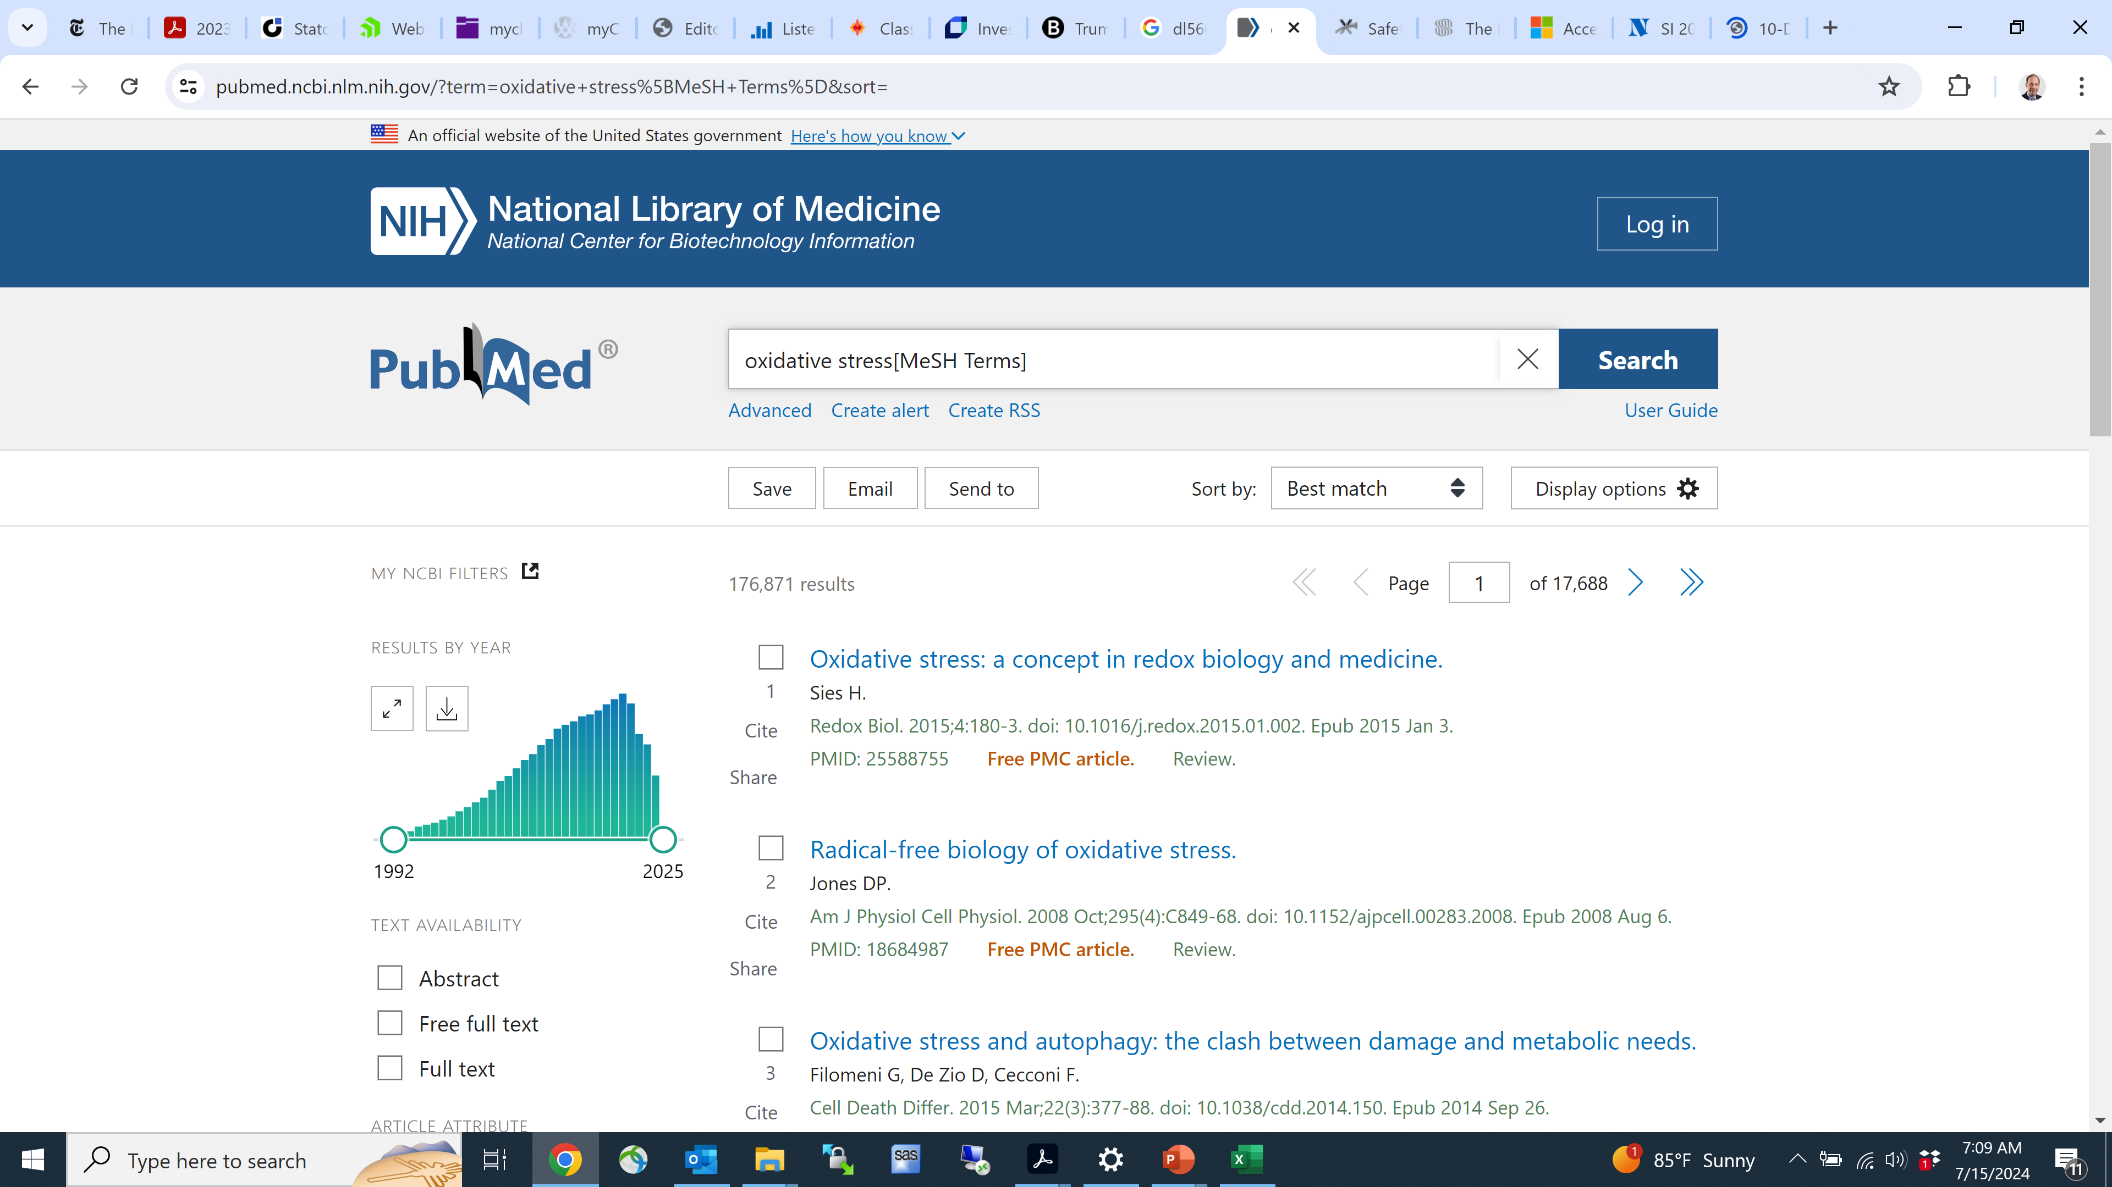

Slide 10
RANK | FREQUENCY | HEADING | FIRST_YEAR
1 | 195,584 | COVID-19 | 2019
2 | 162,322 | Oxidative Stress | 1992
3 | 154,372 | Reverse Transcriptase Polymerase Chain Reaction | 1994
4 | 142,552 | SARS-CoV-2 | 2019
5 | 135,213 | Polymorphism, Single Nucleotide | 1997
6 | 92,688 | Nanoparticles | 2000
7 | 67,087 | HEK293 Cells | 2001
8 | 66,247 | Proteomics | 1999
9 | 63,546 | Real-Time Polymerase Chain Reaction | 2002
10 | 62,884 | Tandem Mass Spectrometry | 2001
11 | 60,947 | Transcriptome | 2002
12 | 55,791 | RNA Interference | 2000
13 | 49,822 | Green Fluorescent Proteins | 1992
14 | 48,295 | Anti-HIV Agents | 1991
15 | 46,057 | Metal Nanoparticles | 2001
16 | 45,147 | Tomography, Optical Coherence | 1994
17 | 44,500 | Xenograft Model Antitumor Assays | 1994
18 | 44,424 | High-Throughput Nucleotide Sequencing | 2008
19 | 42,902 | Nanostructures | 2000
20 | 42,706 | Molecular Dynamics Simulation | 1999

Slide 11
No. of Mesh Descriptors ever established has increased at average annual rate of 0.8%.

Slide 12
Econometric model of mortality
To investigate econometrically the impact that biomedical innovation had on premature mortality in the U.S. during the period 1999-2019, we will estimate many versions of the following model:
ln(mortality_{dt}) = β_{k} vintage_measure_{d,t-k} + α_{d} + δ_{t} + ε_{dt} (1)
where mortality_{dt} is one of the following variables:
ypll85_{dt} | = the number of years of potential life lost before age 85 due to disease d in year t (t = 1999, 2000, …, 2019)
ypll75_{dt} | = the number of years of potential life lost before age 75 due to disease d in year t
ypll65_{dt} | = the number of years of potential life lost before age 65 due to disease d in year t
and vintage_measure_{d,t-k} is one of the following variables:
vint_mean_{d,t-k} | = the mean vintage (year of first appearance in PubMed) of descriptors of articles about disease d published in year t-k (k = 0, 2, …, 20)
post1990%_{d,t-k} | = the fraction of descriptors of articles about disease d published in year t-k that first appeared in PubMed after 1990

Slide 13
Racial differences?
To explore whether biomedical innovation had different effects on the mortality of whites and blacks, we also estimate models using race-specific mortality data.

Slide 14
vintage_measure_{d,t-k} is one of the following variables:
vint_mean_{d,t-k} | = the mean vintage (year of first appearance in PubMed) of descriptors of articles about disease d published in year t-k (k = 0, 2, …, 20)
post1990%_{d,t-k} | = the fraction of descriptors of articles about disease d published in year t-k that first appeared in PubMed after 1990

Slide 16
Lags

Slide 17
Timing of the relationship between the frequency of PubMed descriptors and the frequency of use of the drug
We estimated the following model, using data on about 600 drugs:
n_rx_{st} = ρ_{k} n_descriptors_{s,t-k} + α_{s} + δ_{t} + ε_{st} (2)
n_rx_{st} | = the estimated number (in millions) of U.S. outpatient prescriptions for drug (chemical substance) s in year t (t = 1996, 1997, …, 2021)
n_descriptors_{s,t-k} | = the number of times the descriptor of drug s occurred in PubMed in year t-k (k = 0, 1, 2, …, 20)

Slide 19
Results
Our estimates indicate that premature mortality from a disease is significantly inversely related to the lagged vintage of descriptors of articles about the disease.
For example, the number of years of potential life lost before age 75 due to a disease is significantly inversely related to the mean vintage of descriptors 2-16 years earlier; it is most strongly inversely related to the vintage of descriptors 12 years earlier.
This lag is not surprising: we show that the number of prescriptions for a drug is significantly positively related to the number of PubMed descriptors of the drug 6-14 years earlier. It is most strongly related to the number of PubMed descriptors of the drug 10 years earlier.

Slide 20
Figure 3
Estimates of β_{k} from eq. (1): ln(mortality_{dt}) = β_{k} vintage_measure_{d,t-k} + α_{d} + δ_{t} + ε_{dt}

Slide 21
Figure 3 (continued)
Estimates of β_{k} from eq. (1): ln(mortality_{dt}) = β_{k} vintage_measure_{d,t-k} + α_{d} + δ_{t} + ε_{dt}
Each estimate is from a separate regression.
Disturbances were clustered within diseases.
Solid squares denote statistically significant estimates; the large solid squares denote the most significant estimates, and hollow squares denote statistically insignificant estimates.

Slide 22
From 1999 to 2019, the age-adjusted mortality rate (excluding deaths from unintentional injury, suicide, and homicide) from all diseases declined by approximately 20%--about 1% per year.
Our estimates imply that, in the absence of biomedical innovation, age-adjusted mortality rates would not have declined.
Also, from 1975 to 2019, the age-adjusted cancer mortality rate declined by approximately 27%. Our estimates also imply that, in the absence of biomedical innovation, the age-adjusted cancer mortality rate would not have declined.
Some factors other than biomedical innovation (e.g., a decline in the smoking rate and an increase in educational attainment) probably contributed to the decline in mortality.
But other factors (e.g., a rise in obesity and the prevalence of chronic conditions) undoubtedly contributed to an increase in mortality.

Slide 23
Figure 5
Estimated 1999-2019 changes in age-adjusted mortality rates from all diseases in the presence and absence of biomedical innovation

Slide 24
Figure 5 (continued)
Estimated 1999-2019 changes in age-adjusted mortality rates from all diseases in the presence and absence of biomedical innovation

Slide 26
Racial differences?
To explore whether biomedical innovation had different effects on the mortality of whites and blacks, we also estimate models using race-specific mortality data.
Our estimates indicate that biomedical innovation reduced the mortality of white people sooner than it reduced the mortality of black people, and that the mortality of black people was not reduced by the most recent innovations.

Slide 27
Figure 4
Estimates of β_{k} from eq. (1): ln(mortality_{dt}) = β_{k} vintage_measure_{d,t-k} + α_{d} + δ_{t} + ε_{dt}, by race

Slide 28
Cross-disease spillover effects
Estimates of eq. (1) will not capture cross-disease spillover effects: the potential effects of biomedical innovation for one disease (e.g., hypertension) on mortality from other diseases (e.g., acute cerebrovascular disease (stroke)).
Although some spillover effects are adverse, others—perhaps most—are positive.
Prince et al (2007) argued that “mental disorders increase risk for communicable and non-communicable diseases, and contribute to unintentional and intentional injury. Conversely, many health conditions increase the risk for mental disorder, and comorbidity complicates help-seeking, diagnosis, and treatment, and influences prognosis.”
The NIH National Institute on Aging (2024) says that “conditions such as diabetes, depression, and stroke may increase a person’s risk for Mild Cognitive Impairment.”

